Slide 1







nature friends
3r - recycle, reduce, reuse
ERASMUS+
KA220-SCH - COOPERATION PARTNERSHIPS IN SCHOOL EDUCATION
Developing the Quality of STEAM Educational Studies in Early Childhood Education
2023-1-RO01-KA220-SCH-000154872
GRĂDINIȚA CU PROGRAM PRELUNGIT NR. 7 DEVA

Slide 2
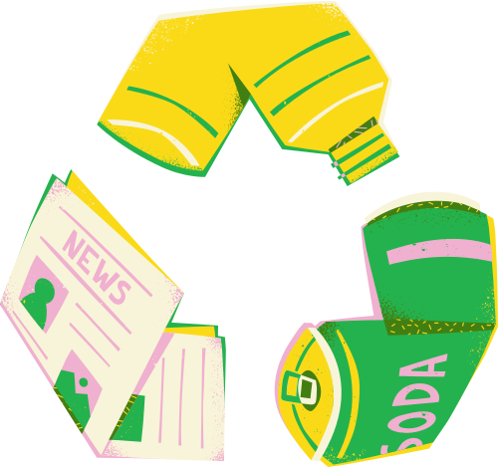


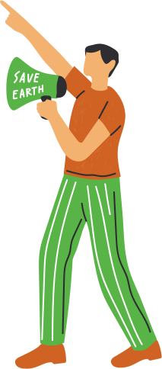

ACQUISITIONS AND CONCEPTS RELATED TO THE ACTIVITY
SC
SCIENCE - What is the meaning of Reuse, Reduce and Recycling
TEHNOLOGY and
ENGINEERING - How to Reuse, Reduce and Recycle
ART - Recycling art
MATHEMATICS - Sort, count and match

Slide 3
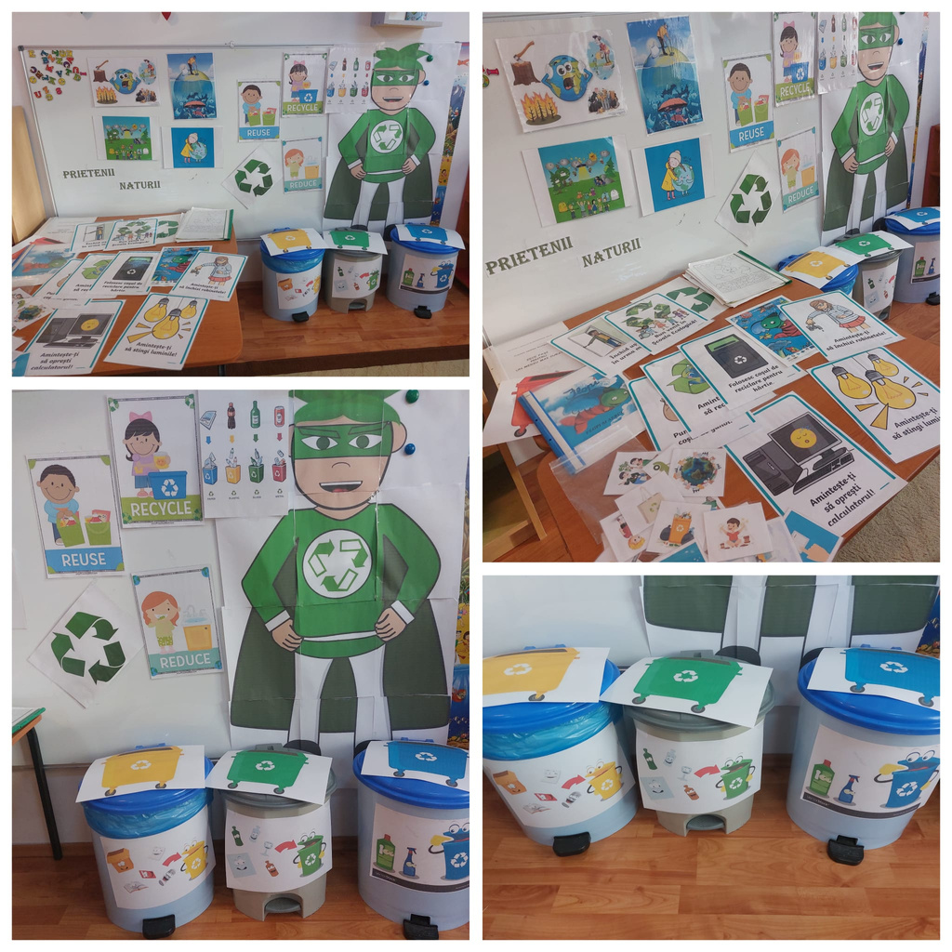
THE THEME CENTER

Slide 4
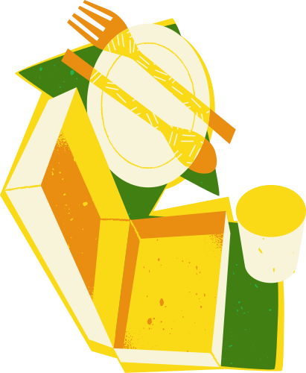
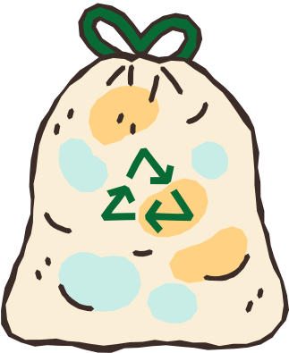

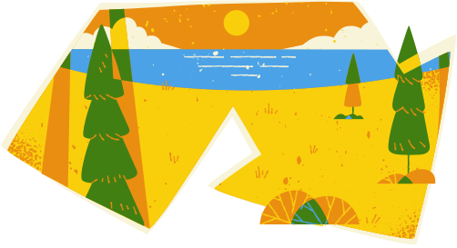
ENGAGE
  The teacher presents a short clip –
  Captain Planet ( https://www.youtube.com/watch?v=W7eJGV8QWps ) and discusses about polution (how people can harm the Earth)
  We can help the planet with 3R:
  - Reduce means to minimise the amount of waste we create.
  - Reuse means to find new ways to use things that otherwise would have been thrown out.
  - Recycle means to turn something old and useless into something new and useful.

Slide 5
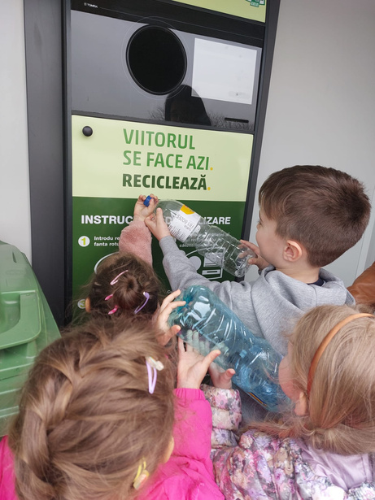

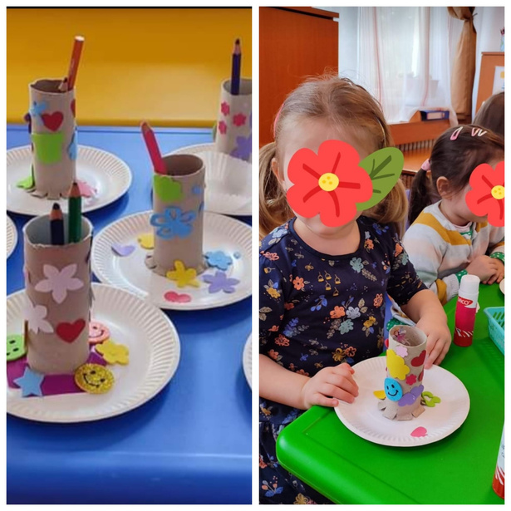
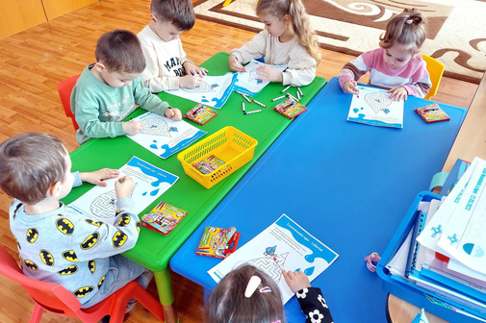

RECYCLE
EXPLORE
The children sort the trash (plastic, paper and glass)
The children explore (groups activities)
REUSE
How we can reuse objects from the recycle bin?
The children made pencils holders using the tisue carbords.
REDUCE
How we can reduce consumtion?
The children learn about taking care of water resurses

Slide 6


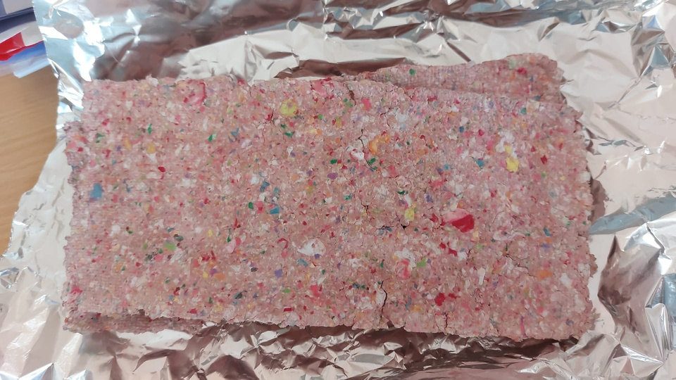
EXPLAIN
How can we reuse the paper
Experiment: Recycled paper
materials
a plastic box
paper
water
sponge
frames with mesh attached to it
bug screen /strainer
cloth sheets for transfering the paper

Slide 7
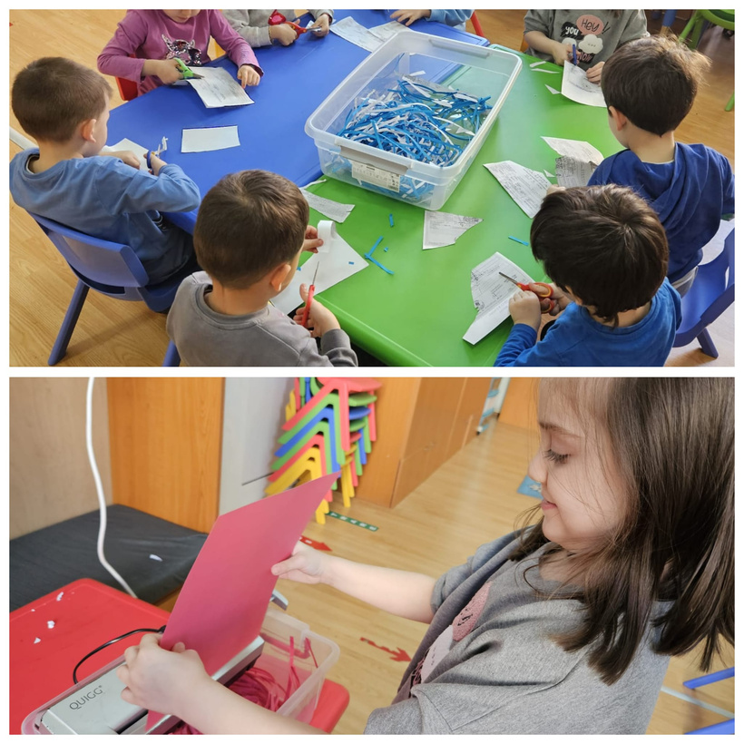
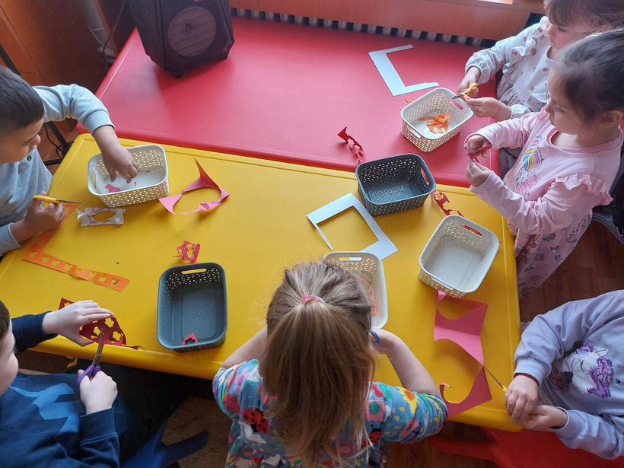
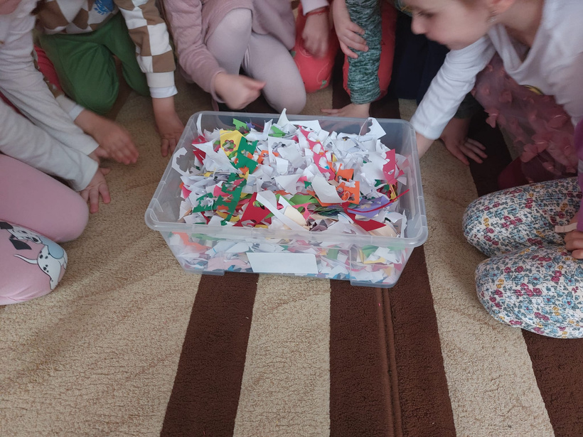
HOW TO DO?
Children cut / shred the used paper and put it in a box. They put water over it until everything is covered.

Slide 8
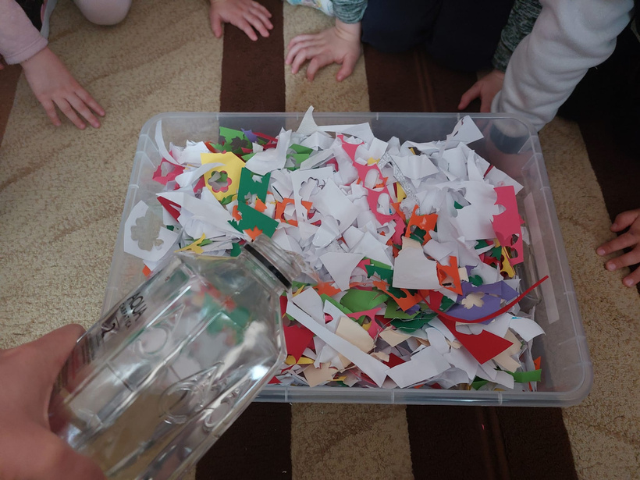
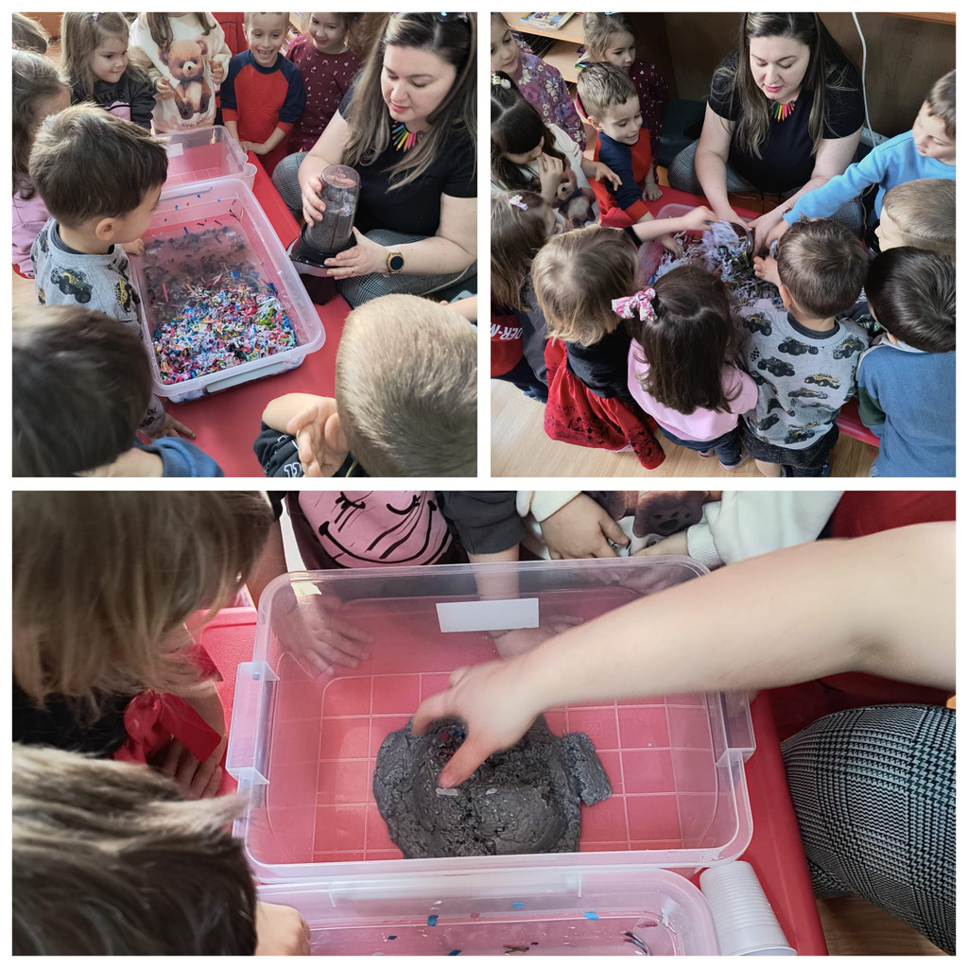
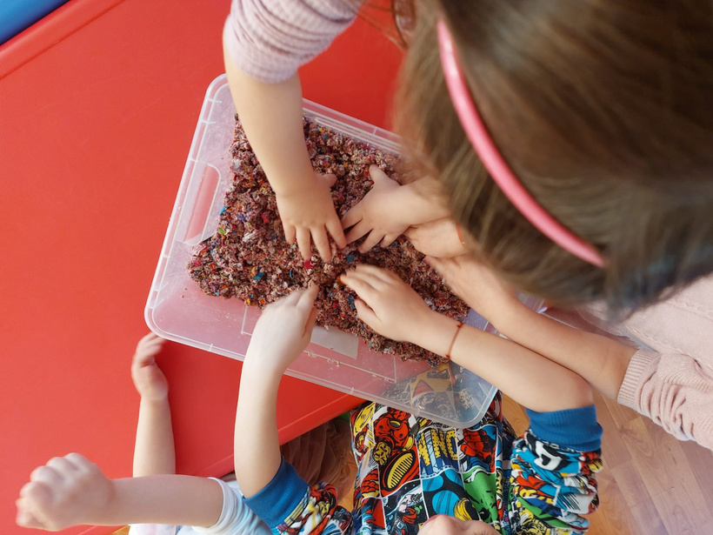
We let it soak in the water for two days, then we mash it with our hands or use a blender until it becomes a pulp.

Slide 9
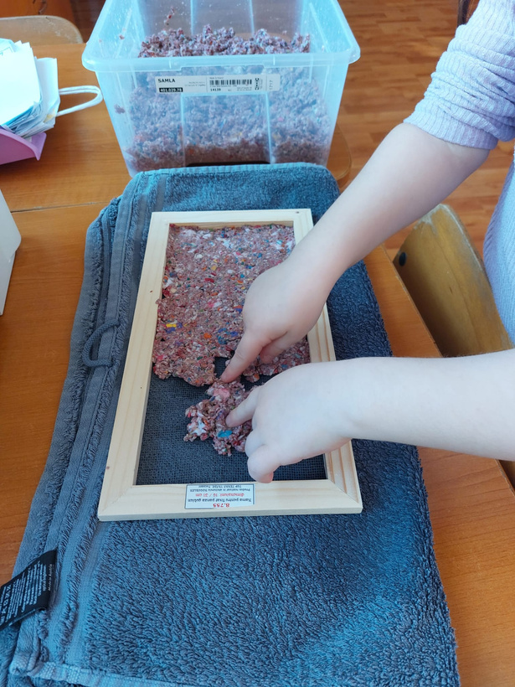
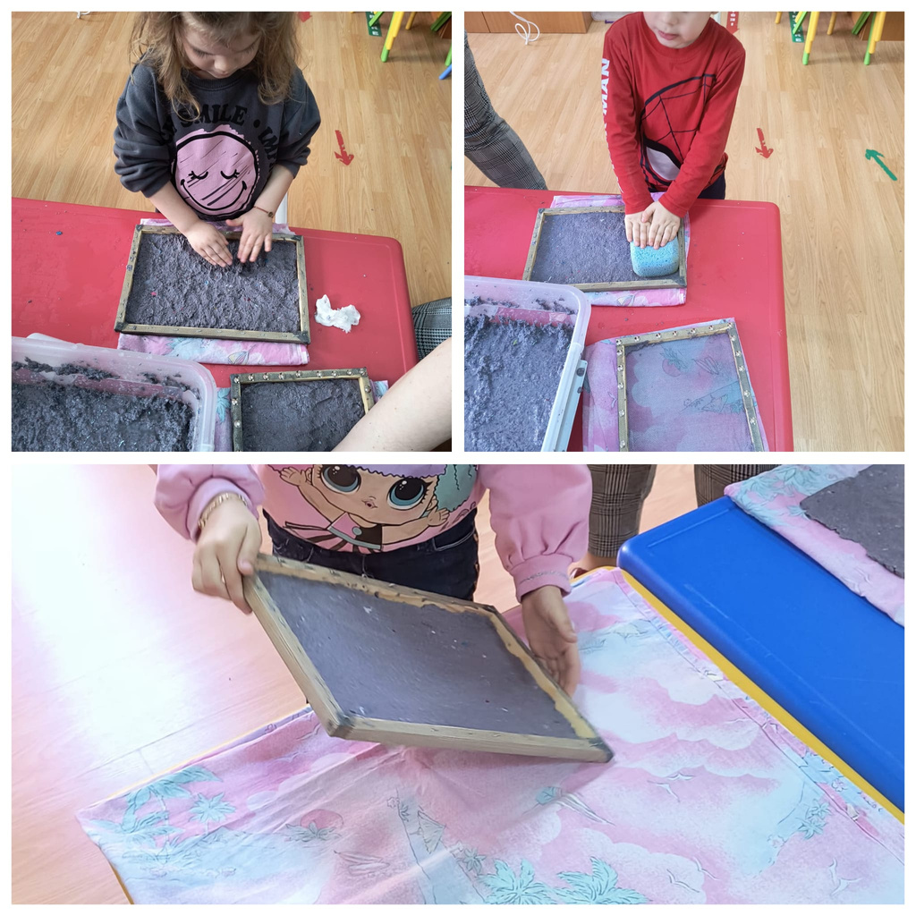
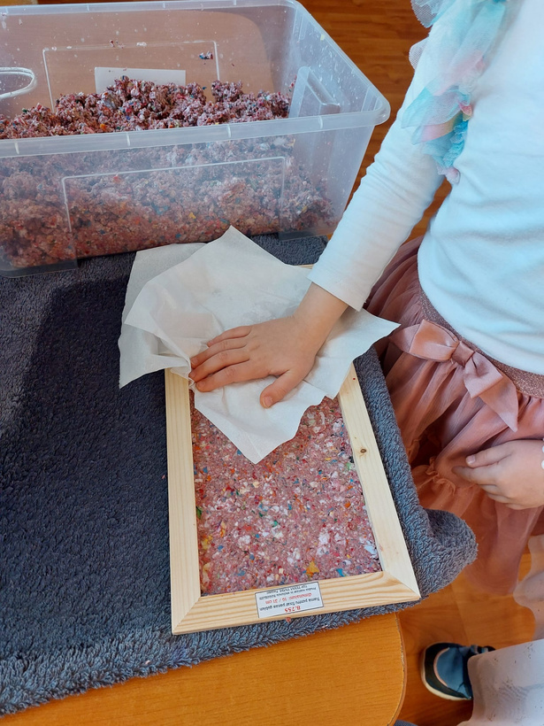
The mashed paper is pressed into the frame and soaked all the watter out of it with the help of the sponge. Then it is transfered tot a piece of cloth and left to dry.

Slide 10
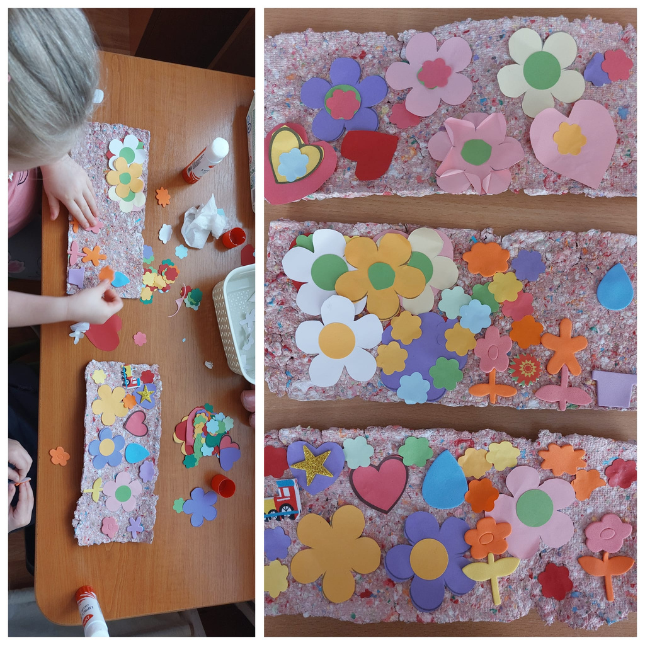
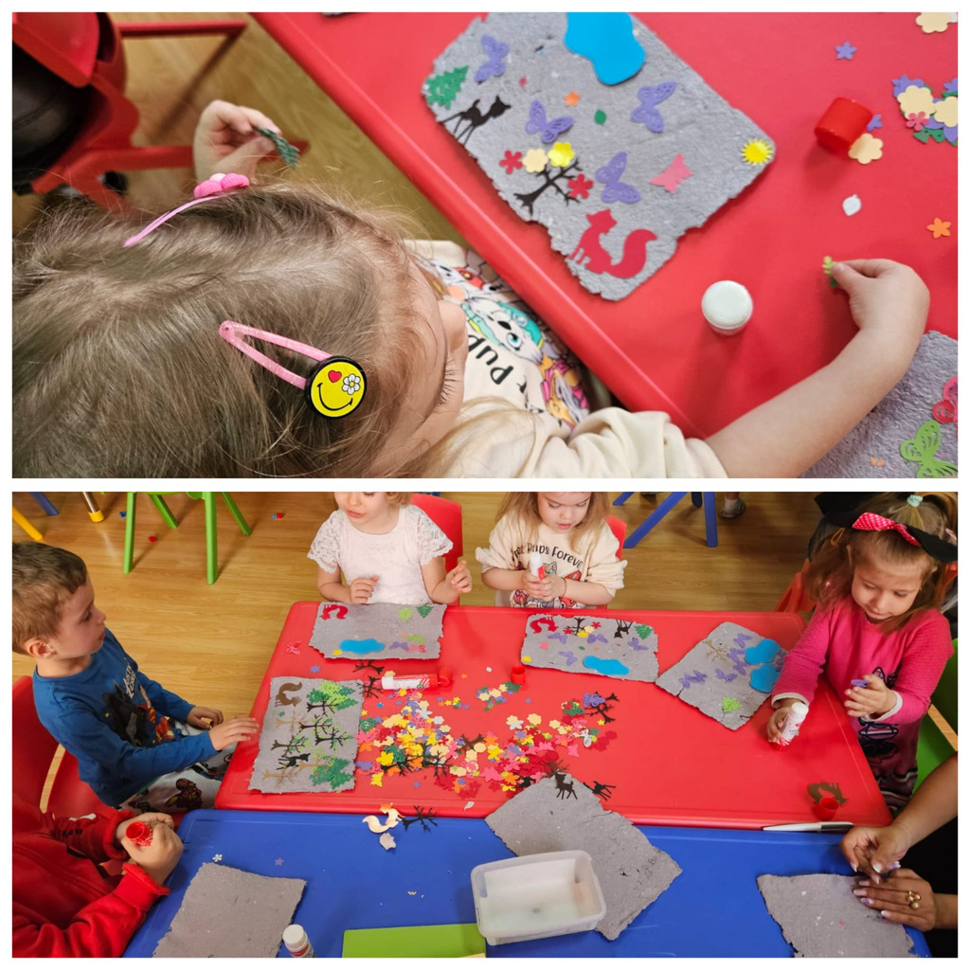
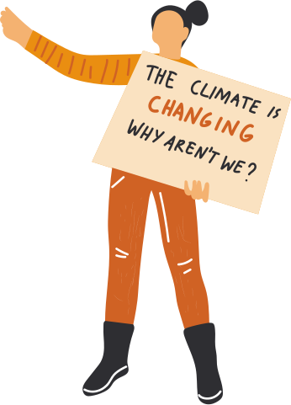
THE END RESULT
The obtained paper is used in Arts

Slide 11
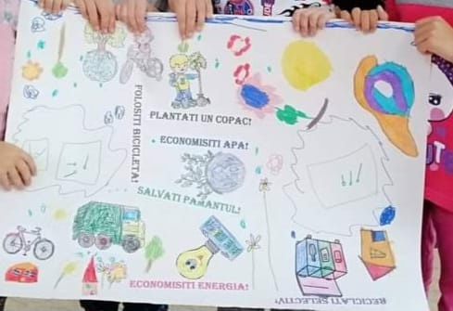
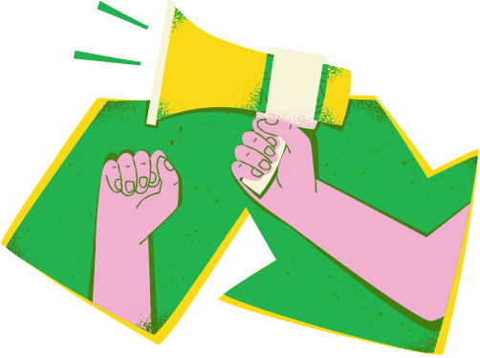
ELABORATE
POSTER
The class is divided into 2 groups .
·The first group has the task of creating a poster that encourages 3R (Reduce, Reuse, Recycle)

Slide 12
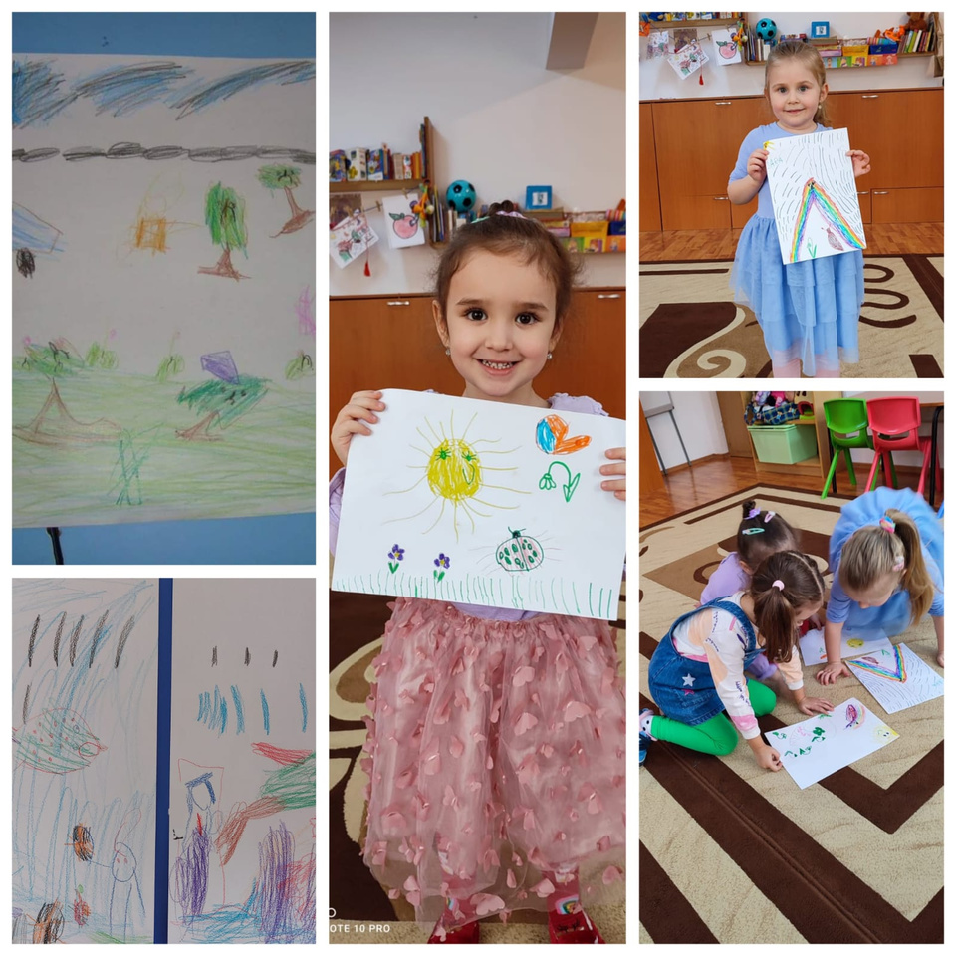
ELABORATE
DRAWINGS
·The second group makes drawings with the theme Nature - my friend

Slide 13
EVALUATION
THEACHER EVALUATION
STUDENT EVALUATION
Has the concept of 3R been explained?
Have children learned enough about 3R?
Has sufficient information been obtained about the 3R ?
Did the activities attract the attention of the students?
Did all the students participate willingly during the study?
Were their designs competible when working as a team?
Were they able to explain their work clearly when giving a design presentation?
Did you enjoy examining 3R?
Do you want to save the planet?
Are you surprised that there are people how don’t love to recycle?
How did feel while you clean the nature?
How did you feel when you touched the reciclet paper?
Did you have any difficulties while designing the poster?
Which topic were you most interested in while doing this?

Slide 14
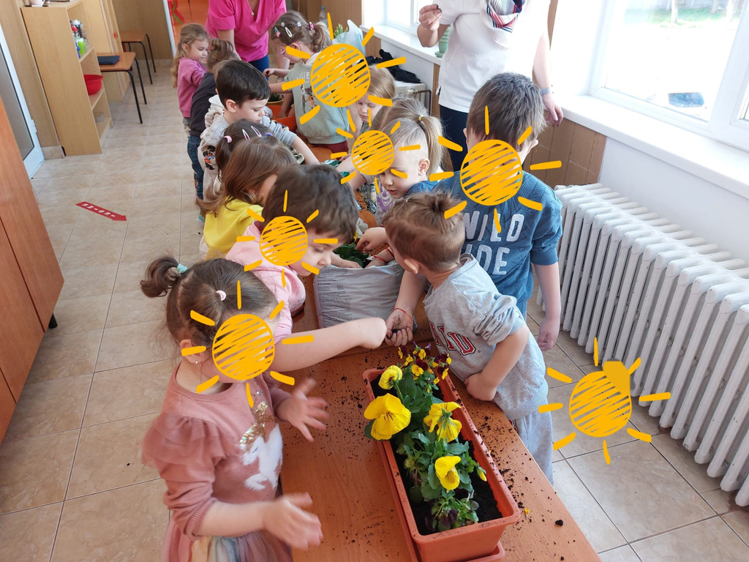
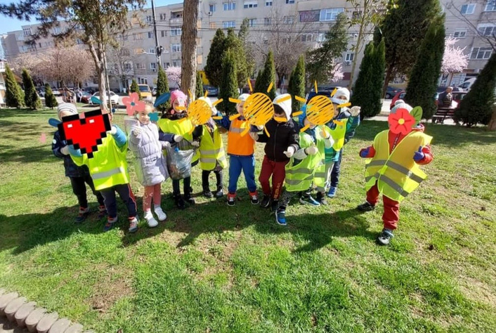
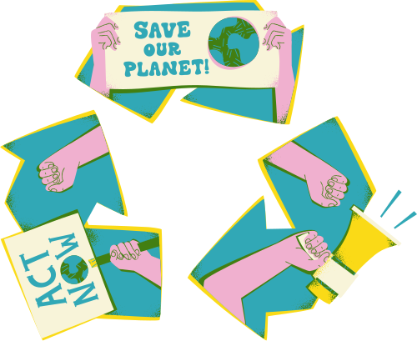
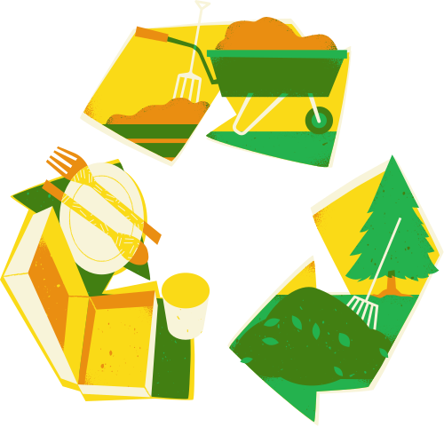
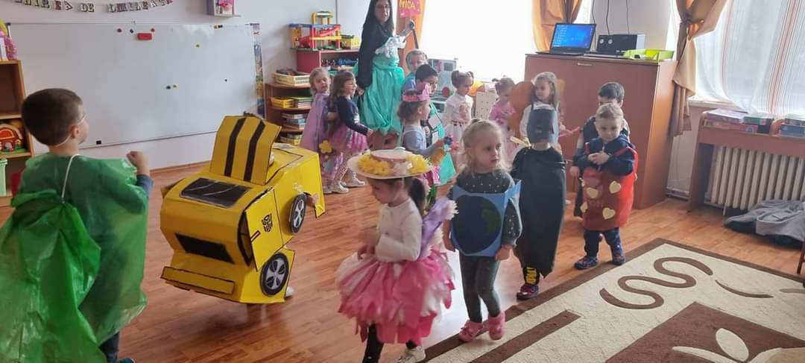

OTHER ACTIVITIES
Cleaning activity
  Planting flowers
  Recycled costumes

Slide 15
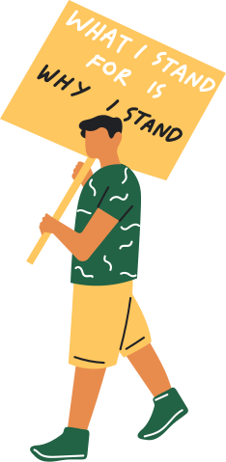
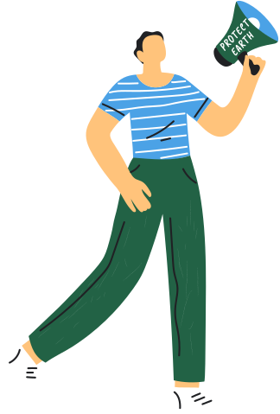
Thank You
Have a Great Day
the template is from www.canva.com

